Slide 1
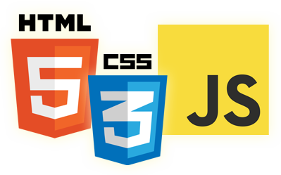


Reference Types
Eyal Vardi
Microsoft MVP ASP.NET blog: eyalvardi.wordpress.com

Slide 2
Agenda
Working with objects.
Arrays.
JavaScript date types.
Primitives & primitive wrappers.

Slide 3
Reference Types
A reference value (object) is an instance of a specific reference type.
ECMAScript provides a number of native reference types, such as Object.
var person = new Object();
person.name = "Nimrod";
person.age = 29;

Slide 4
Reference Types

Slide 5
The Object Type
There are two ways to explicitly create an instance of Object.
new operator
Object literal
var person = {};
//same as
var person = new Object();
var person = {
name : "Nicholas",
age : 29
};

Slide 6
Dynamic Properties
With reference values, at any time you can:
add, change, or delete properties and methods.
// Reference Type
var person = new Object();
person.name = "Nike";
alert(person.name); //"Nike"
// Primitive Type
var name = "Nicholas";
name.age = 27;
alert(name.age); //undefined
Heap
Obj1 | (Object Type)
Obj2 | (Object Type)
object

Slide 7
Array

Slide 8
Array Type
//create an array with three items
var colors = new Array(3); // Equal to Array(3);
//create an array with one item, the string “Greg”
var names = new Array("Greg");
//creates an array with three strings
var colors = ["red", "blue", "green"];
//creates an empty array
var names = [];
//creates an array with three strings
var colors = ["red", "blue", "green"];
colors[colors.length] = "black"; //add a color (position 3)
colors[colors.length] = "brown"; //add a color (position 4)

Slide 9
Stack Methods
An array object can act just like a stack (LIFO)
var colors = new Array();
var count = colors.push("red", "green");
alert(count); //2
count = colors.push("black");
alert(count); //3
var item = colors.pop(); //get the last item
alert(item); //”black”
alert(colors.length); //2
push
red
gre
bla
pop

Slide 10
Queue Methods (FIFO)
var colors = new Array();
var count = colors.push("red", "green");
alert(count); //2
count = colors.push("black");
alert(count); //3
var item = colors.shift();
alert(item); //”red”
alert(colors.length); //2
push
red
gre
bla
shift

Slide 11
unshift() and pop()
It adds any number of items to the front of an array and returns the new array length.
var colors = new Array();
var count = colors.unshift("red", "green");
alert(count); //2
count = colors.unshift("black");
alert(count); //3
var item = colors.pop();
alert(item); //”green”
alert(colors.length); //2
unshift
bla
red
gre
pop

Slide 12
Array Methods
Reordering:
reverse()
sort()
Manipulation:
concat()
slice()
splice()
Location:
indexOf()
lastIndexOf()
Iterative:
every()
filter()
forEach()
map()
some()
reduce()
reduceRight()

Slide 13
Date

Slide 14
Date Type
When the Date constructor is used without any arguments, the created object is assigned the current date and time.
Date-Formatting Methods:
toXXXString()
var now = new Date();
var someDate = new Date("May 25, 2004");

Slide 15
The Regexp Type
ECMAScript supports regular expressions through the RegExp type. Regular expressions are easy to create using syntax similar to Perl, as shown here:
var expression = /pattern/flags;

Slide 16
Wrapper Types

Slide 17
Primitive Wrapper Types
Every time a primitive value is read, an object of the corresponding primitive wrapper type is created behind the scenes, allowing access to any number of methods for manipulating the data.
Boolean, Number & String
var s1 = "some text";
var s2 = s1.substring(2);
var s1 = new String("some text");
var s2 = s1.substring(2);
s1 = null;

Slide 18
Primitive Wrapper Lifetime
A reference type using the new operator, it stays in memory until it goes out of scope.
Primitive wrapper objects exist for only one line of code before they are destroyed.
Calling typeof on an instance of a primitive wrapper type returns “object”.
var s1 = "some text";
s1.color = "red";
alert(s1.color); //undefined

Slide 19
The Boolean Wrapper
All primitive wrapper objects convert to the Boolean value true.
var falseObject = new Boolean(false);
var result = falseObject && true;
alert(result); //true
var falseValue = false;
result = falseValue && true;
alert(result); //false

Slide 20
Singleton Built-in Object

Slide 21
Global Object
The Global object “catchall” properties and methods that don’t otherwise have an owning object.
All variables and functions defined globally become properties of the Global object.

Slide 22
Windows Object
Web browsers implement it such that the window is the Global object’s delegate.
All variables and functions declared in the global scope become properties on window.
var color = "red";
function sayColor(){ alert(window.color); }
window.sayColor(); //red
var global = function () {
return this;
}();

Slide 23
The Math Object
ECMAScript provides the Math object as a common location for mathematical formulas and information.
The Math object execute faster than if you were to write the computations in JavaScript directly.

Slide 24
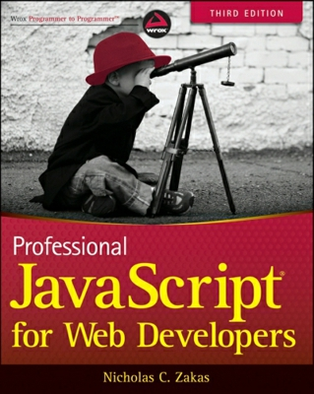
Resources
Professional JavaScript for Web Developers
Good links:
http://eyalvardi.wordpress.com/resources/html-5-course-resourses/javascript/

Slide 25
Thanks
eyalvardi.wordpress.com
Eyal Vardi
Microsoft MVP ASP.NET blog: eyalvardi.wordpress.com

